Slide 1

Vehicle Recall Comparisons
Rakim T. Reid

Slide 2



Agenda
Introduction
Overview and Problem Statement
Business Problem
Descriptive statistics
Data Analyzed
Results
Recommendations and Summary

Slide 3




Introduction
Recently, Tesla recalled 362,758 vehicles due to the beta version of its Full Self-Driving software may cause crashes. Another notable case was the Ford Pinto in the 1970s. According to the U.S. Department of Transportation: "manufacturers who determine that a product or piece of original equipment either contains a safety defect or is not in compliance with Federal safety standards are required to notify NHTSA within five business days."

Slide 4

Overview and Problem Statement

Slide 5
Business Problem
Recall information is a valuable consideration when deciding which vehicle to purchase. That is why this dataset is meaningful, engaging, and relevant.
For example, recently, Tesla recalled 362,758 vehicles due to the possibility of Full Self-Driving Beta software may cause crashes. Then there are cases like Ford and the Ford Pinto where the company refused to acknowledge a problem, and severe injuries and deaths occurred.

Slide 6
Typical Recall Timeline
Notification
Receive a notice in the mail or see the recall on the news.
Why me?!?!
Don’t panic.
Verify
Make sure your vehicle is actually being recalled via your local dealership of the brand of your car. Have your VIN ready.
Is it really bad?
Repairs
Get a repair timeline. Find out the cost if your car is more than 10 years old. If less than 10 years old, then the repair is free.
Every recall is not a severe problem. Sometimes a component may wear out early.

Slide 7

Dataset Utilized
Vehicle Recalls Dataset from U.S. Department of Transportation
Data acquired via API
Contains 26,699 rows as of February 28, 2023.

Slide 8
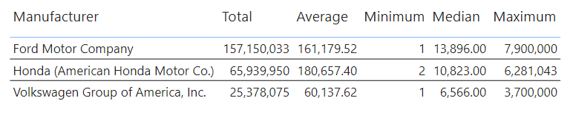
Descriptive Statistics

Slide 9
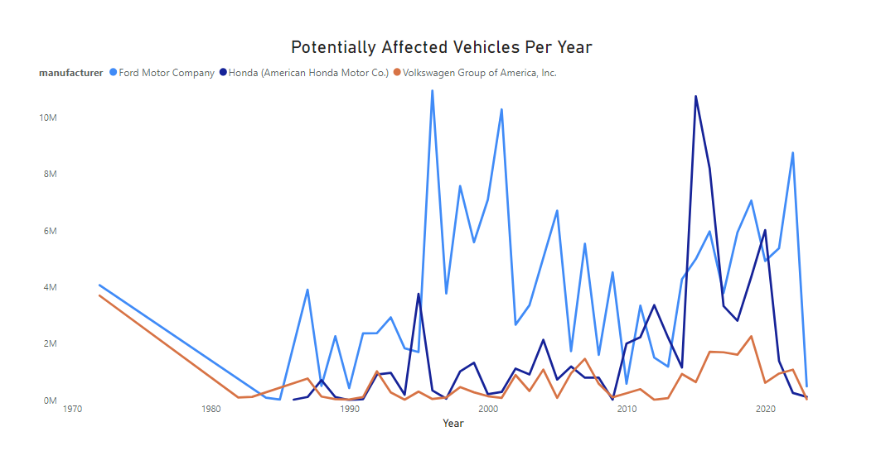
Manufacturers have an interesting track record for vehicles recalled.
Ford has the highest number of vehicles recalled over multiple years.
Volkswagen (VW) consistently has the fewest vehicles recalled.
Honda has the second highest amount, but has for many years been near VW.

Slide 10
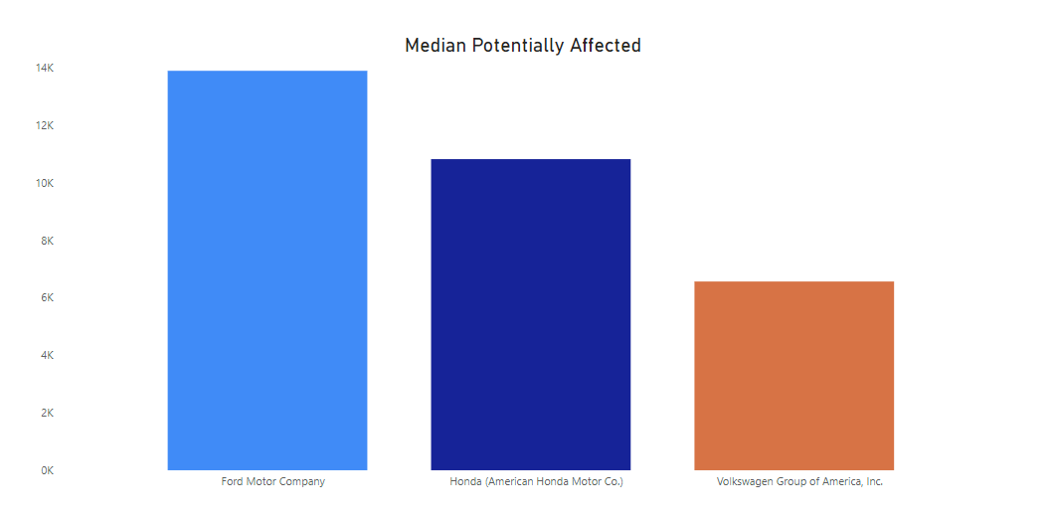
These findings hold true even when mitigating the pull of outliers with the median.

Slide 11

Method
One-way Analysis of Variance test (ANOVA) for three vehicle manufacturers.
Removed rows with zero recalls to account for years without any recalls.
Subsetted dataset to contain Ford, Honda and Volkswagen data only.

Slide 12

Results
The overall ANOVA test was significant (p = 0.000082, where p < 0.05).
The post-hoc Tukey results were significant for the Ford-VW pairing and Honda-VW pairing.

Slide 13

Summary
There are significant differences for the Ford and Volkswagen pairing AND the Honda and Volkswagen pairing. P-values are less than 0.05 for both pairings.
The confidence interval for Ford-Volkswagen is -161817.1627 to -40,395.2451 and -194,983.5101 to -46,056.0474. In recent years, Volkswagen has been the number one (or very close to the number one spot) globally, but not in the US. Ford and Honda are more popular in the US. Given the lower number of Volkswagen sales and less popularity in the U.S. compared to Ford and Honda, there have been fewer vehicles affected by recalls. An interesting finding is that the test did not find Ford and Honda as statistically the same. If you are choosing one of the more popular car manufacturers for a purchase, recalls may play a relatively less important role in decisions -- averaged over the years 1966 to February 2023.
"""

Slide 14


Thank You
Rakim T. Reid
rakimreid@gmail.com
https://github.com/rakimreid

